Slide 1
Ajax Patterns

Slide 2
Patterns
Multi Stage Download
Periodic Refresh
Predictive Fetch
Fallback Patterns
Submission Throttling

Slide 3
Multi Stage Download

Slide 4
Introduction
■
■
■
Content – Time-consuming to load (rich images). Users rarely need to read all the content.
Users click several times – to locate a particular item.
Users browse around by exploring links between pages.
Application – download a lot of content from the server
■
■
■
How can you optimize downloading performance?

Slide 5
Solution
■
Break content download into multiple stages Prioritize content
Initial download – very small (skeleton)
Content for each placeholder (eg., div) downloaded independently
XMLHttpRequest Calls – issued simultaneously or in a serial sequence
■
■
■
■

Slide 6
<body onload = "startIt()">
<header>
<img id = "logo" height = "75" width = "75" src = "loading.gif"/>
<h1 class = "h_1"> WELCOME TO LMS <h1>
</header>
<div id = "search">
<img id = "search" height = "100" width = "100" src = "loading.gif"/>
</div>
<div>
<h2> Individual departments are here </h2>
<ul id = "links">
<img height = "200" width = "200" src = "loading.gif"/>
</ul>
</div>
<div id = "search_res">
</div>

Slide 7
<script type="text/javascript">
xhr_1 = new XMLHttpRequest(); xhr_2 = new XMLHttpRequest(); xhr_3 = new XMLHttpRequest();

Slide 8
function startIt() { setTimeout(loadLogo, 2000);
setTimeout(loadSearchBox, 4000);
setTimeout(loadLinks, 6000);
}
function loadLogo()
{
document.getElementById("logo").src = "PES.bmp"
}
function loadSearchBox()
{
xhr_2.onreadystatechange = showSearchBox; xhr_2.open("GET", "http://localhost/get_search_box.php", true); xhr_2.send();

Slide 9
function showSearchBox()
{
if (xhr_2.readyState == 4 && xhr_2.status == 200)
{
document.getElementById("search").innerHTML
= xhr_2.responseText;
}
}
function searchISBN() {
var isbn = document.getElementById("isbn"); xhr_3.onreadystatechange = showSearchResults; xhr_3.open("GET", "http://localhost/search.php? isbn=" + isbn.value, true);
xhr_3.send();
}

Slide 10
function showSearchResults()
{
if (xhr_3.readyState == 4 && xhr_3.status == 200)
{
document.getElementById("search_res").innerH TML = xhr_3.responseText;
}
}
function loadLinks()
{
xhr_1.onreadystatechange = showLinks; xhr_1.open("GET", "http://localhost/links.txt", true);
xhr_1.send();
}

Slide 11
get_search_box.php
<?php
header("Content-type : text/html"); extract($_GET);
echo "<label>";
echo "ISBN Number : <input type = 'text' id
= 'isbn'/><p/>" ; echo "</label>";
echo "<input type = 'submit' value = 'SEARCH' onclick = 'searchISBN()' />" ;
?>

Slide 12
search.php
<?php
extract($_GET);
$file = fopen("book_db.txt", "r");
$found = false;
while($line = fgets($file)) {
$line = trim($line);
$l_arr = explode(",", $line);
if ($isbn == $l_arr[0]) { echo "<h2> Book Info. </h2>";

Slide 13
Contd…
echo "ISBN : $l_arr[0] <br>"; echo "Author : $l_arr[1] <br>";
echo "Publication : $l_arr[2] <br>"; echo "Price : $l_arr[3] <br>";
echo "Title : $l_arr[4] <br>"; echo "</h3>";
$found = true; break;
}}
if(!$found) {
echo "<h2> No matching book found in database !! </h2>"; }
?>

Slide 14
function showLinks()
{
if (xhr_1.readyState == 4 && xhr_1.status == 200)
{
var link_placeholder = document.getElementById("links"); link_placeholder.innerHTML = "";
var links = xhr_1.responseText; var lines = links.split("\n");
for(var i = 0; i < lines.length; ++i)

Slide 15
var line = lines[i];
var link = line.split(",");
var a = document.createElement("a");
a.setAttribute("href", link[1]); a.innerHTML = link[0];
var li = document.createElement("li"); li.appendChild(a);
link_placeholder.appendChild(li);
}}
}

Slide 16
Periodic Refresh

Slide 17
Introduction
It is a design pattern
Process of checking for new server information in specific intervals
Used to increase user experience
Notify users of updated information
also called polling

Slide 18
Contd…
location.reload() and
setTimeout() – methods for refresh

Slide 19
Real World Examples
ESPN : Update online scoreboards automatically
Gmail : Notify users of the new mail
Live Chat

Slide 20
Auto Refresh - Example
<html lang="en">
<head>
<title> Auto refresh current page with JS</title>
<script> setTimeout(function(){
location.reload();
},3000); // 3000 milliseconds means 3 seconds.
</script>
</head>
<body>
<h1>Hello, world!</h1>
</body>

Slide 21
<script>
$(document).ready( function() {
setInterval(function() { var randomnumber = Math.floor(Math.random() * 100);
$('#show').text(
'I am getting refreshed every 3 seconds..! Random Number => '
+ randomnumber);
}, 3000);
});
</script>

Slide 22
Predictive Fetch

Slide 23
Introduction
Fetch on demand - the user’s action tells the server what data should be retrieved
Guesses what the user is going to do next and retrieves the appropriate data
Eg: Reading an online article – 3 pages
attempts to remove the delay
requires a browser-side cache
Google Maps

Slide 24
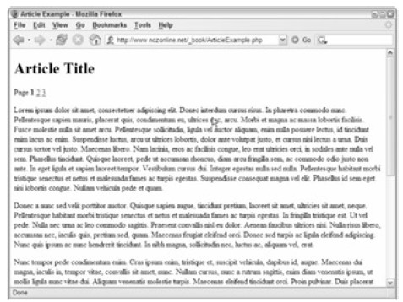

Slide 25
<html xmlns="http://www.w3.org/1999/xhtml" xml:lang=" en" lang=" en">
<head>
<title>Article Example</title>
<script type=" text/javascript" src=" zxml.js"></script>
<script type=" text/javascript" src=" Article.js"></script>
<link rel=" stylesheet" type=" text/css" href=" Article.css" />
</head>

Slide 26
<body>
<h1>Article Title</h1>
<div id=" divLoadArea" style=" display:none"></div>
<?php
$output = "<p>Page "; for ($i=1; $i < 4; $i++) {
$output .= "<a href=\" ArticleExample.php? page=$i\" id=\"aPage$i\"";
if ($i==$page) {
$output .= "class=\" current\"";
}
$output .= ">$i</a> ";
}
echo $output;
}

Slide 27
if ($page==1) { echo $page1Text;
} else if ($page == 2) { echo $page2Text;
} else if ($page == 3) { echo $page3Text;
}
if (!$dataOnly) {
?>
</body>
</html>
<?php
}
?>

Slide 28
ArticleExample.php
<?php
$page = 1;]
$dataOnly = false;
if (isset($_GET["page"]))
{
$page = (int) $_GET["page"];
}
if (isset($_GET["data"]) && $_GET["dataonly"]
== "true") {
$dataOnly = true; } if (!$dataOnly) {
?>

Slide 29
Fallback Patterns

Slide 30
Introduction
If there's an error on the server?
If the request never makes it to the server?
Status other than 200
If a file is not found (404) or
An internal server error occurred (302)
Periodic refresh?
Sol: simply cancel all pending requests.
Alert: don't send any more requests

Slide 31
Submission Throttling

Slide 32
Introduction
Solves - when to send user data to the server.
Traditional - each click – request to the server - aware of what the client is doing
Consider user typing a letter..
Create a large number of requests in a short time – also UI may slow down

Slide 33
Solution
Buffer the data to be sent to the server on the client
Send the data at predetermined times
A client-side function is called to begin the buffering of data.
User's status is checked to see if user is idle or not
If the user is still active, data continues to be collected

Slide 34
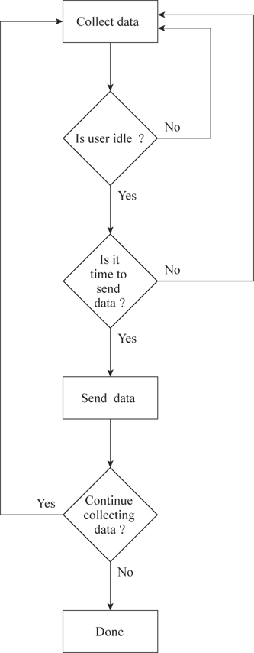

Slide 35
Dynamic Script Loading

Slide 36
Dynamically create script tag and inject into the DOM
<script type="text/javascript"> (function() { var script = document.createElement("script"); script.type = "text/javascript";
script.async = true; script.src = "min.js";
(document.getElementsByTagName('head')[0]
|| document.getElementsByTagName('body') [0]).appendChild(script);
})();
</script>

